Slide 1


Sam K
Data Scientist@SpaceY
October 19, 2022

Slide 2

Outline
Executive Summary
Introduction
Methodology
Results
Conclusion
Appendix

Slide 3
Executive Summary
Since the cost of rocket launch depends heavily on the re-use of the first stage rocket, and also on various other factors such as flight number, payload, 0rbit, etc. SpaceY needs to determine whether it is feasible to re-use the first stage rocket by evaluating the data of a competitor SpaceX and needs to find how the other factors have played a role in the success of SpaceX. By analyzing the existing data, SpaceY expect to draw the right intelligence to make its business decisions.
Summary of methodologies
Solution of the issue used the Foundational Methodology in Data Science. It consists of:
Problem Understanding using the Analytical Approach
Understanding of the Data Requirements and Data Collection
Exploratory Data Analysis using SQL and Visualization
Data Preparation/Data Wrangling
Modeling using different regression and classification algorithms
Measurement of the accuracy of the model and Evaluation using metrics.
Deployment of the model
Feedback

Slide 4
Introduction
Project background and context
SpaceX is a rocket launching company that has successfully deployed payloads into space with the lowest cost in the industry. SpaceX’s cost savings come from reusing the first stage rocket.
SpaceY company wants to get into the rocket launching business. They want to study the current players in the market and their success factors and cost structure. They started with analyzing the data available from competitor SpaceX both from their website and from the public data available on web.
Problems you want to find answers
SpaceY wants to find out:
how the payload affects success
how the location of the launch makes a difference in success rate
how the flight experience (number of flights) affecting the success, etc.
the cost associated with the first stage landing successfully

Slide 5

Section 1

Slide 6
Methodology
Executive Summary
Data collection methodology:
Main data collection was from a SpaceX REST API, by using multiple endpoints
Data available in wiki pages were collected using web scraping
Perform data wrangling
HTML tables were extracted using BeautifulSoup to data frame
Perform exploratory data analysis (EDA) using visualization and SQL
Exploratory data analysis was performed using SQL and various data points were calculated and compared.
Perform interactive visual analytics using Folium and Plotly, Dash
Geographical data analysis is conducted by Folium.
Using Plotly, various charts such as bar chart, scatter graph, line charts were created to perform data analysis
Perform predictive analysis using classification models
Logistic, KNN, Tree, SVC are used to make classification models

Slide 7
Data Collection
The main data is collected from a SpaceX Rest API using requests package and get method.
The result obtained from API was converted to JSON objects using .json() method.
JSON objects are converted to Pandas Data Frame using json_normalize()
The Falcon 9 flight data was collected from the Wiki pages using BeautifulSoup package.
Data was read into data frame using Pandas read_html method.

Slide 8
Data Collection – SpaceX API
Data collection with SpaceX REST API
import requests library
use .get() to get http response from API
use .json() to convert to JSON
use Pandas library and .json_normalize() to convert to Data Frame.
GitHub URL of the completed SpaceX API calls
https://github.com/samk-watson/Capstone/blob/main/jupyter-labs-spacex-data-collection-api.ipynb
response = requests.get(url)
data = response.json()
df = pd.json_normalize(data)
Get data from Rest API
Convert the data to JSON
Convert JSON to Data Frame

Slide 9
Data Collection – Web Scraping
web scraping process
from bs4 import BeautifulSoup
Using requests.get(url).text, get the html page.
Parse this document using BS, to get a nested html tree structure
Using Pandas read_html, read the tables from html to data frame.
Extract the data from tables/<tr> and <td>
GitHub link
https://github.com/samk-watson/Capstone/blob/main/jupyter-labs-webscraping.ipynb
html = requests.get(url).text
soup=BeautifulSoup(html,’html.parser’)
data =pd.read_html(str(table), ‘bs4”)
Get html page from url
Create a BeautifulSoup Object from the html
convert html table into data frame

Slide 10
Data Wrangling
Converted the categorical values for Landing Outcomes for rocket into training labels 1 for successful and 0 for unsuccessful landing.
Github:
https://github.com/samk-watson/Capstone/blob/main/labs-jupyter-spacex-Data%20wrangling.ipynb
Identified the unique Outcome values using value_counts()
Created a landing_outcome label from Outcome column
Enumerated the Outcome values and created a bad_outcome set for landing failures
Created a classification variable and assigned values 0 and 1 based on whether the outcome is in bad_outcome set or not

Slide 11
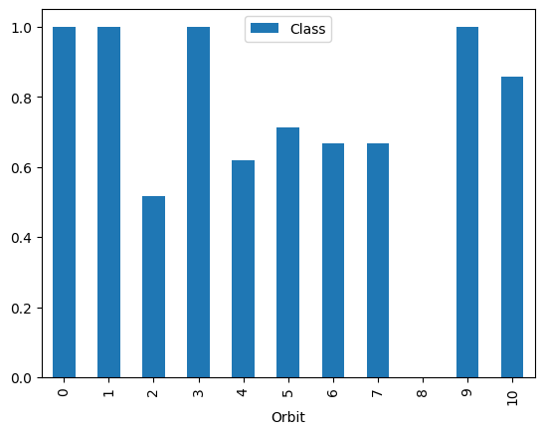
EDA with Data Visualization – 1 (contd..)
Charts used for Visualization:
A catplot from seaborn library used to visualize the relationship
between Flight Number and Payload Mass have with launch outcome.
between Launch Site and Payload to the launch outcome.
A bar chart (shown at right) is plotted to visualize the relationship between Orbit Type and Success Rate.
Github link
https://github.com/samk-watson/Capstone/blob/main/jupyter-labs-eda-dataviz.ipynb

Slide 12
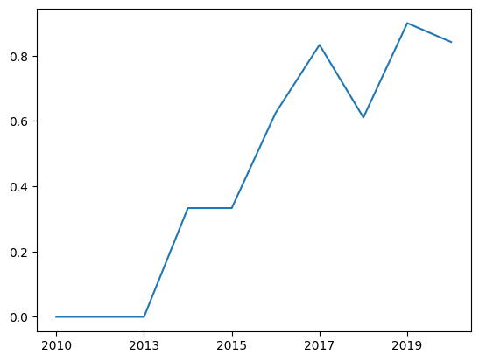
EDA with Data Visualization – 2
Scatter plots from Matplotlib library are used to visualize the relationship
between Orbit Type and Flight Number,
between Orbit Type and Payload
A line chart (shown at right) is used to get the average launch success trend by plotting year on x-axis and success rate on the y-axis.
Github link
https://github.com/samk-watson/Capstone/blob/main/jupyter-labs-eda-dataviz.ipynb

Slide 13
EDA with SQL – 1 (contd…)
The following SQL queries were performed:
To identify the distinct launch sites using DISTINCT clause
select distinct "Launch_Site" from SPACEXTBL
To find the first successful landing outcome has achieved by using MIN(Date)
select min("Date") from SPACEXTBL where "Landing _Outcome" ='Success'
To identify the boosters which have success in drone ship with specific payload mass.
select "Booster_Version" from SPACEXTBL where ("Landing _Outcome" LIKE '%Drone Ship%') AND ("PAYLOAD_MASS__KG_" between 4000 and 6000)
To identify the booster version that have carried the maximum load using subquery.
select "Booster_Version", "PAYLOAD_MASS__KG_" from SPACEXTBL where "PAYLOAD_MASS__KG_" = (select max("PAYLOAD_MASS__KG_") from SPACEXTBL)
Github link:
https://github.com/samk-watson/Capstone/blob/main/jupyter-labs-eda-sql-coursera_sqllite.ipynb

Slide 14
EDA with SQL – 2
To identify the failure launches on drone ship using “LIKE '%Failure (drone ship)%’ “ clause.
select substr(Date,4,2) as month, "Landing _Outcome","Booster_Version", "Launch_Site" from SPACEXTBL where "Landing _Outcome" like '%Failure (drone ship)%’
To order the successful landing outcomes between two dates using GROUP BY and HAVING clauses.
select "Landing _Outcome", count(*) as count1 from SPACEXTBL group by "Landing _Outcome" having "Landing _Outcome" in (select DISTINCT "Landing _Outcome" from SPACEXTBL where ("Date" between "04-06-2010" and "20-03-2017") and ("Landing _Outcome" like "%Success%")) ORDER BY count1 DESC
Github link:
https://github.com/samk-watson/Capstone/blob/main/jupyter-labs-eda-sql-coursera_sqllite.ipynb

Slide 15
Build an Interactive Map with Folium
Summarize what map objects such as markers, circles, lines, etc. you created and added to a folium map
Marked all launch sites – using circle
Marked the success/failed launches on each site using different colors
Calculated distance between launch site and its proximities and marked it on the map using a line
Created marker clusters to simplify the map since many markers have same coordinate.
Explain why you added those objects
Launch success rate may depend on the location and proximities of the launch site. Finding an optimal location for building a launch site is critical.
GitHub URL
https://github.com/samk-watson/Capstone/blob/main/lab_jupyter_launch_site_location_Folium.ipynb

Slide 16
Predictive Analysis (Classification)
Summarize how you built, evaluated, improved, and found the best performing classification model
https://github.com/samk-watson/Capstone/blob/main/SpaceX_Machine%20Learning%20Prediction_Part_5.ipynb
Create a NumPy array from column Class
Standardized the data with StandardScaler()
Fit the model with fit() and use Transform() to convert to a data frame
Apply GridSearchCV on Logreg, Decision Tree, SVM and KNN models
Find the best model by comparing the evaluation metrics
Examine the confusion matrix
Calculate the accuracy and score for all models

Slide 17
Results – 1 (contd…)
Exploratory data analysis results
Visualization Results:
Scatter plot of Payload Mass vs Launch Site shows:
for the VAFB-SLC launch site there are no rockets launched for heavy payload mass(greater than 10000)
Bar chart of Orbit vs Succes Rate shows:
Orbits GEO, ES-L1,HEO, and SSO has high success rates
Scatter plot of Flight number vs. Orbit shows:
LEO and PO orbits, the success is correlated to Flight Numbers.
Scatter plot of Payload Mass vs Orbit shows:
VLEO has more successful landing with heavier payloads
line chart of yearly average success rate shows:
Success rate has increased from 2013 to 2020 with a small blip in 2018
Results based on SQL analysis
booster which have carried the maximum payload mass
the failed landing outcomes in drone ship
Rank the count of Success landing outcomes
average payload mass carried by booster version F9 v1.1

Slide 18
Results – 2
Predictive Analytics Results
Classification Method | Accuracy Gridsearch | Accuracy Score | Best Parameters
Logistic Regression | 0.8472 | 0.8333 | {'C': 0.01, 'penalty': 'l2', 'solver': 'lbfgs'}
SVC | 0.8472 | 0.8333
Decision Tree | 0.903 | 0.7222 | {'criterion': 'entropy', 'max_depth': 12, 'max_features': 'sqrt', 'min_samples_leaf': 2, 'min_samples_split': 5, 'splitter': 'random'}
KNN | 0.8472 | 0.833 | {'algorithm': 'auto', 'n_neighbors': 9, 'p': 1}

Slide 19

Section 2

Slide 20
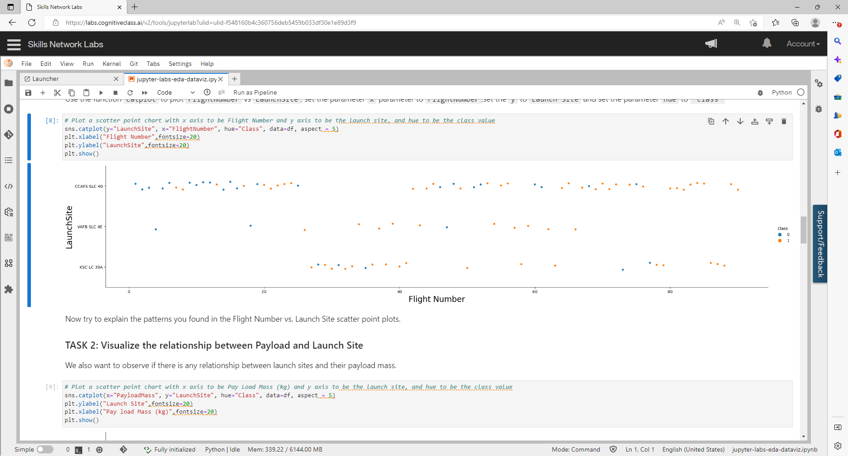
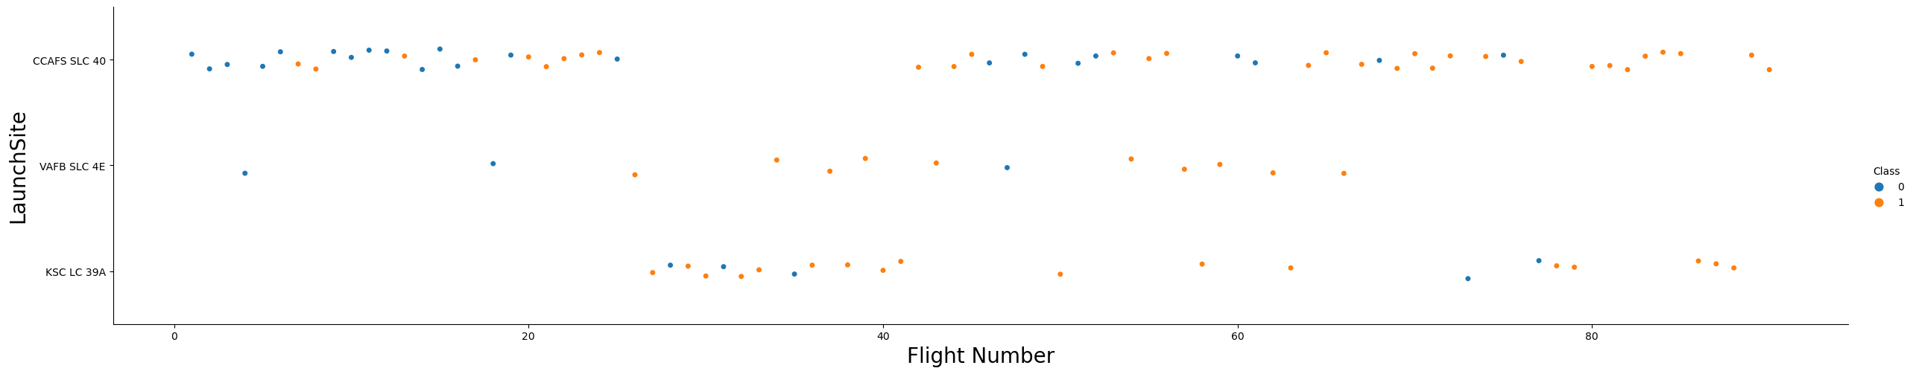
Flight Number vs. Launch Site
Show a scatter plot of Flight Number vs. Launch Site
Show the screenshot of the scatter plot with explanations
--Success rate is different based on launch site

Slide 21
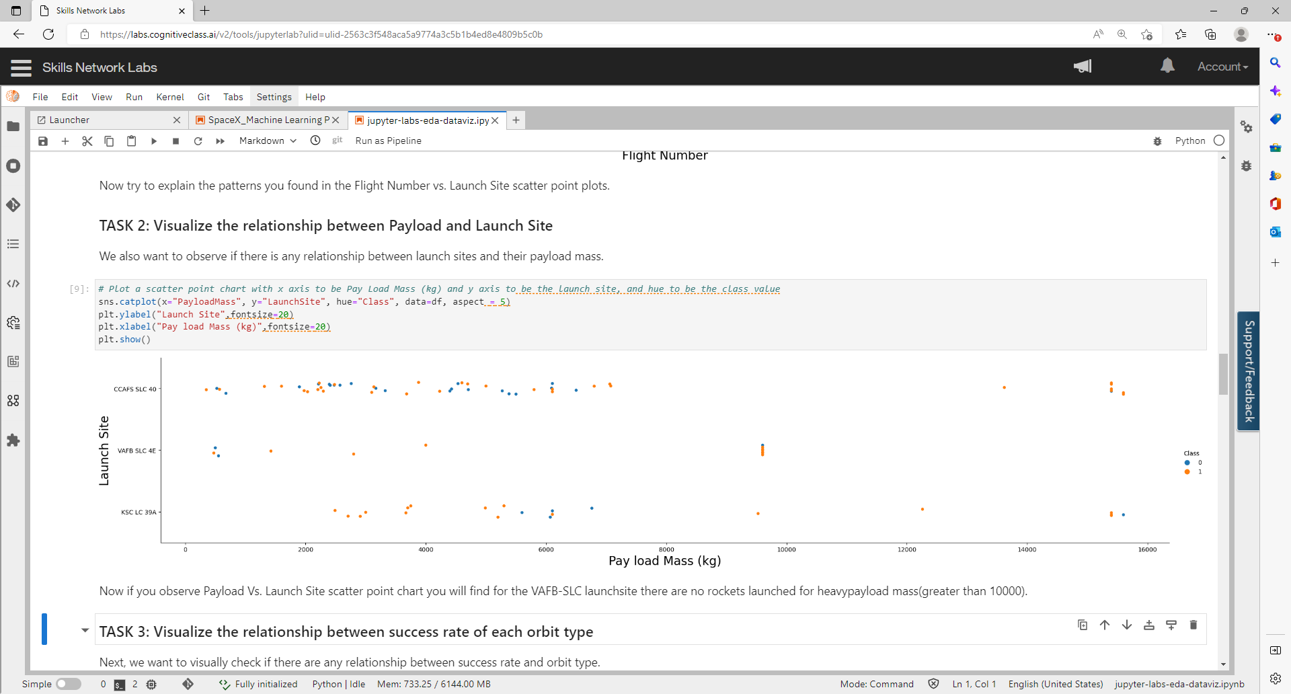
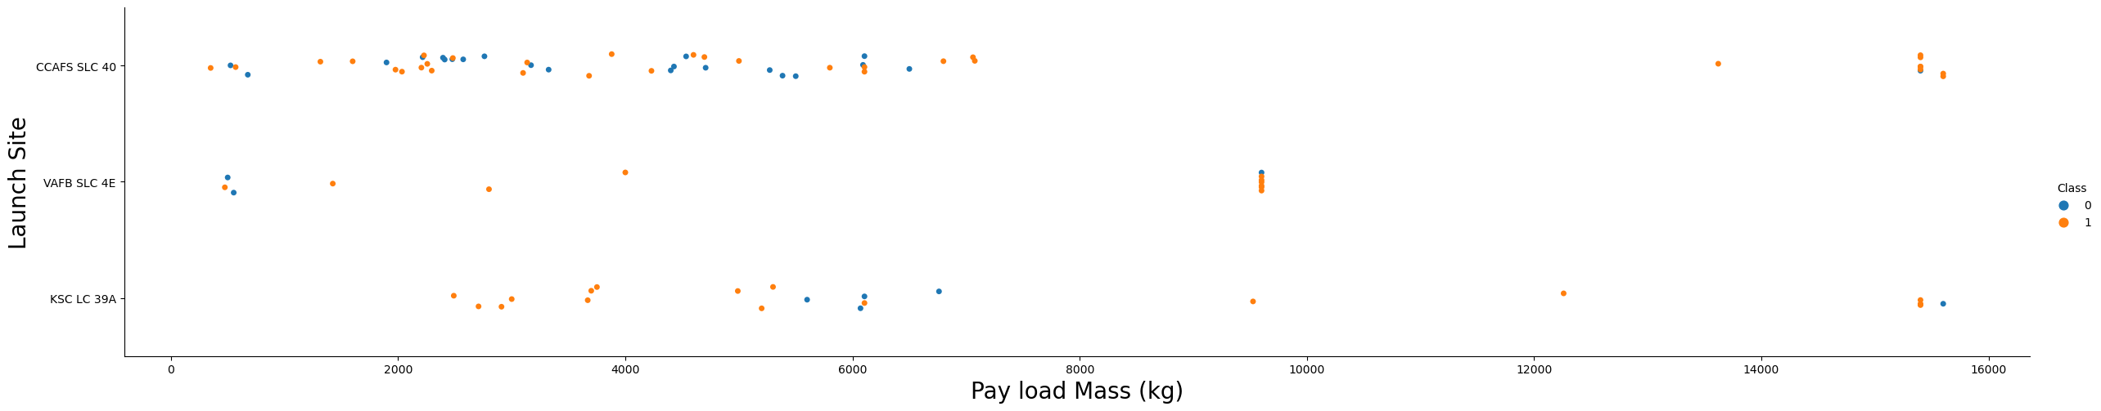
Payload vs. Launch Site
Show a scatter plot of Payload vs. Launch Site
Show the screenshot of the scatter plot with explanations
-- for the VAFB-SLC launchsite there are no rockets launched for heavypayload mass(greater than 10000)

Slide 22
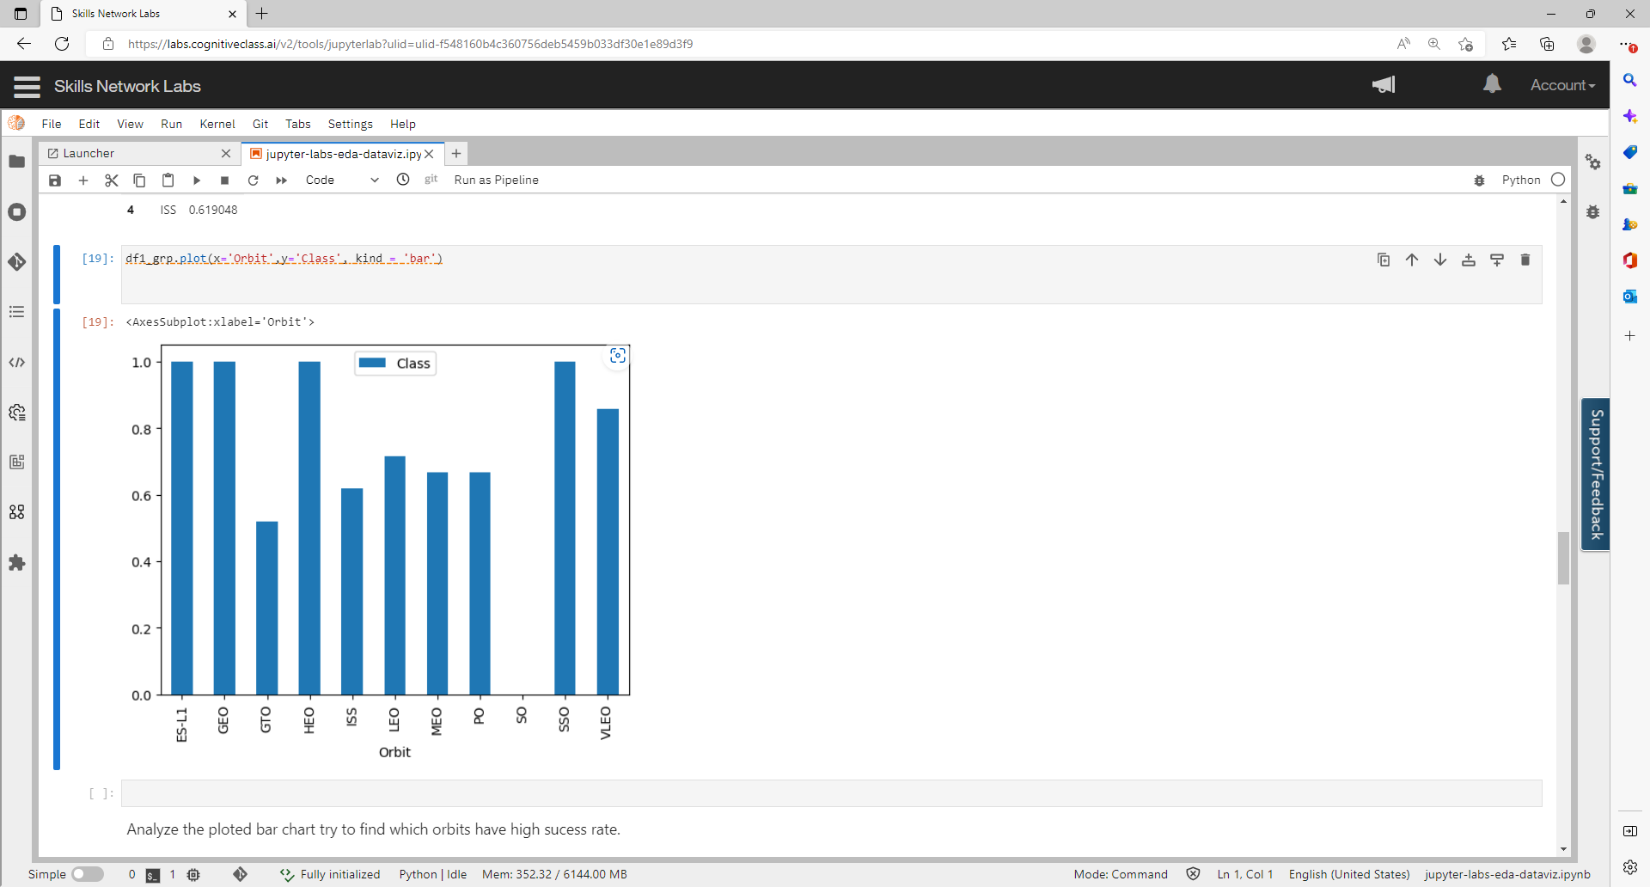
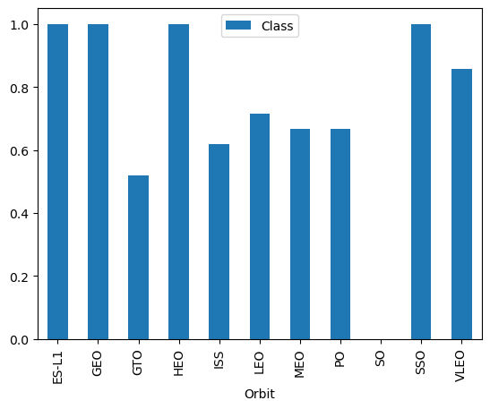
Success Rate vs. Orbit Type
Show a bar chart for the success rate of each orbit type
Show the screenshot of the scatter plot with explanations
-- Orbits GEO, ES-L1,HEO, and SSO has high success rates

Slide 23
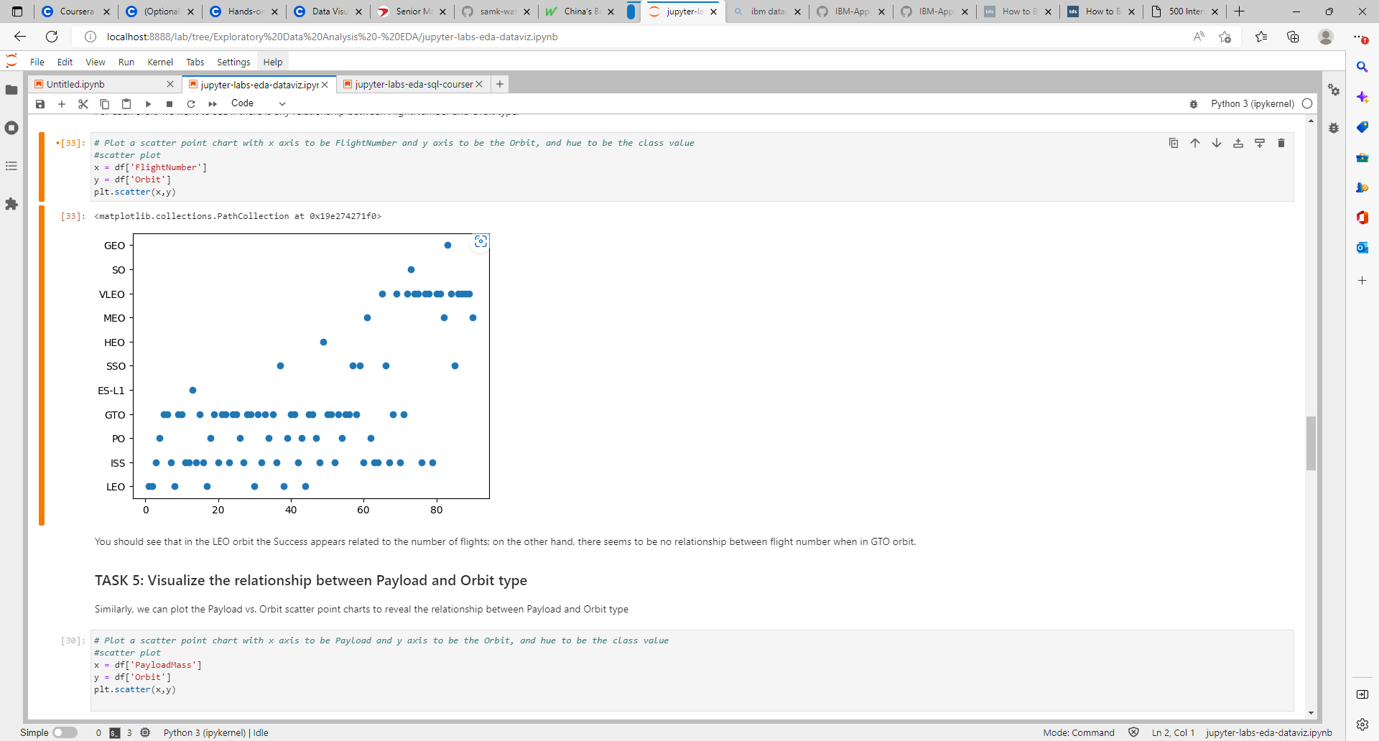
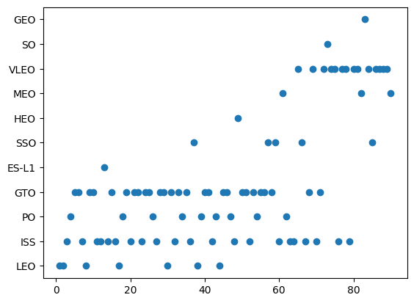
Flight Number vs. Orbit Type
Show a scatter plot of Flight number vs. Orbit
type
Show the screenshot of the scatter plot with explanations
-- In LEO and PO, success is related to the number of flights.

Slide 24
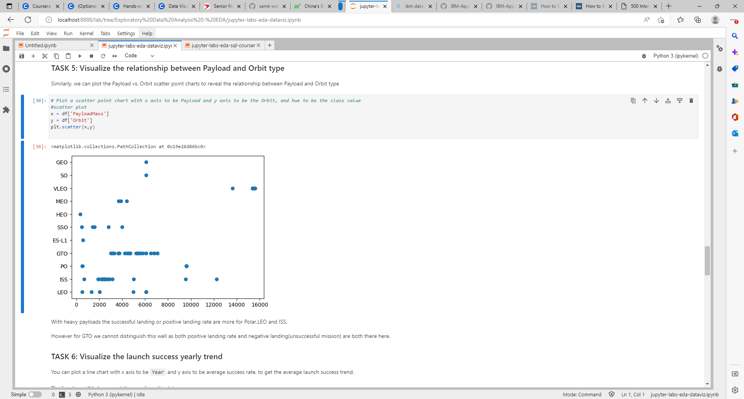
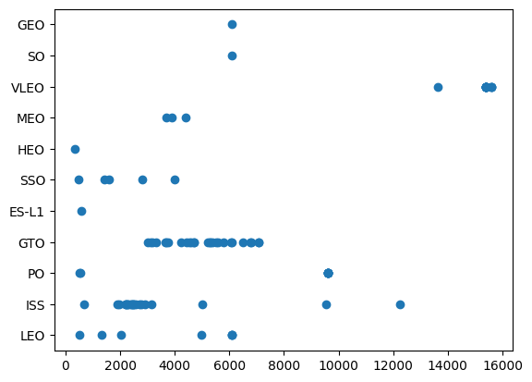
Payload vs. Orbit Type
Show a scatter plot of payload vs. orbit type
Show the screenshot of the scatter plot with explanations
-- VLEO has more successful landing with heavier payloads

Slide 25
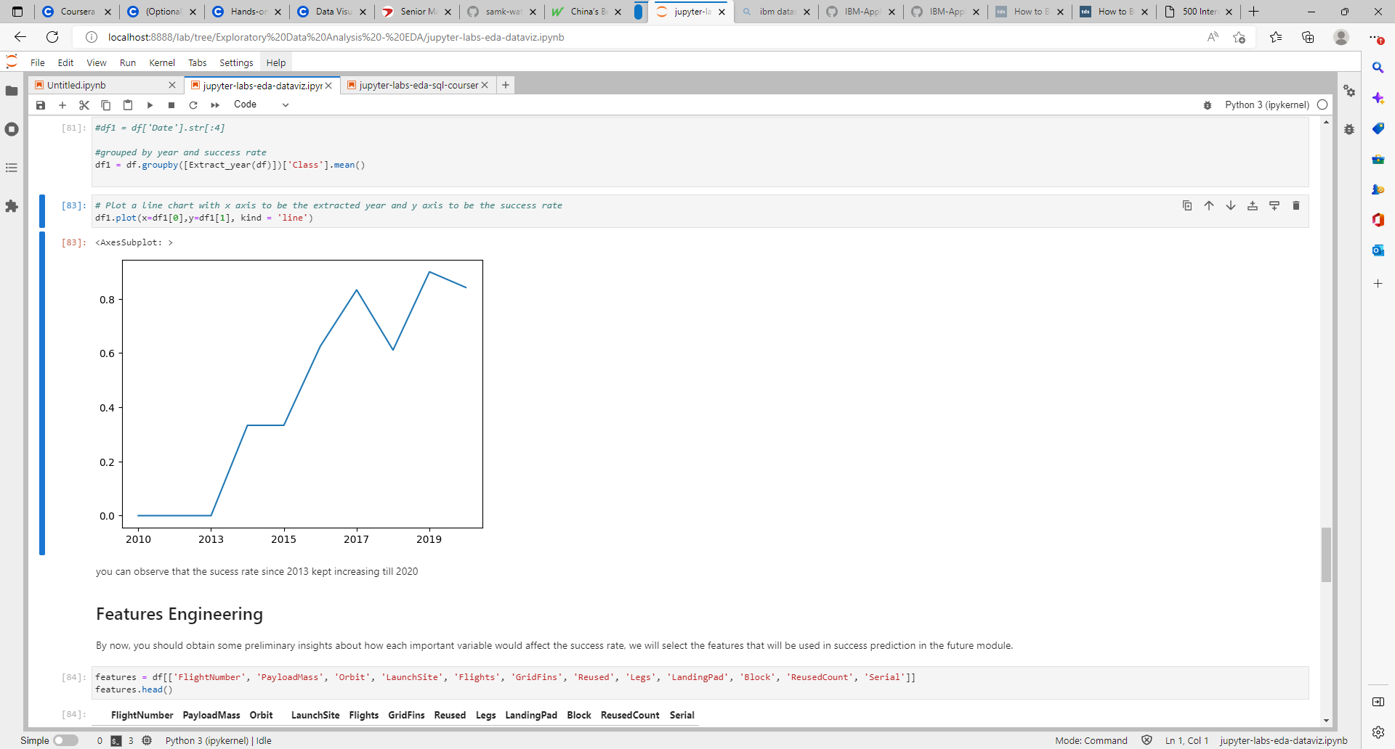
Launch Success Yearly Trend
Show a line chart of yearly average success rate
Show the screenshot of the line chart with explanations
--Success rate has increased from 2013 to 2020 with a small blip in 2018

Slide 26
All Launch Site Names
Unique launch sites
Query:
select distinct "Launch_Site" from SPACEXTBL
--Distinct is used to find the unique values
CCAFS LC-40
VAFB SLC-4E
KSC LC-39A
CCAFS SLC-40

Slide 27
Launch Site Names Begin with 'CCA'
5 records where launch sites begin with `CCA`
Query:
select * from SPACEXTBL where "Launch_Site" LIKE 'CCA%' LIMIT 5
-- To filter sites starting with CCA , LIKE used. LIMIT is used to get the top 5 from the list.
Date | Time (UTC) | Booster_Version | Launch_Site | Payload | PAYLOAD_MASS__KG_ | Orbit | Customer | Mission_Outcome | Landing _Outcome
04-06-2010 | 18:45:00 | F9 v1.0 B0003 | CCAFS LC-40 | Dragon Spacecraft Qualification Unit | 0 | LEO | SpaceX | Success | Failure (parachute)
08-12-2010 | 15:43:00 | F9 v1.0 B0004 | CCAFS LC-40 | Dragon demo flight C1, two CubeSats, barrel of Brouere cheese | 0 | LEO (ISS) | NASA (COTS) NRO | Success | Failure (parachute)
22-05-2012 | 07:44:00 | F9 v1.0 B0005 | CCAFS LC-40 | Dragon demo flight C2 | 525 | LEO (ISS) | NASA (COTS) | Success | No attempt
08-10-2012 | 00:35:00 | F9 v1.0 B0006 | CCAFS LC-40 | SpaceX CRS-1 | 500 | LEO (ISS) | NASA (CRS) | Success | No attempt
01-03-2013 | 15:10:00 | F9 v1.0 B0007 | CCAFS LC-40 | SpaceX CRS-2 | 677 | LEO (ISS) | NASA (CRS) | Success | No attempt

Slide 28
Total Payload Mass
the total payload carried by boosters from NASA
619967 kg
Query:
select sum("PAYLOAD_MASS__KG_") from SPACEXTBL

Slide 29
Average Payload Mass by F9 v1.1
Calculate the average payload mass carried by booster version F9 v1.1
select avg("PAYLOAD_MASS__KG_") from SPACEXTBL where "Booster_Version" LIKE 'F9 v1.1%'
Present your query result with a short explanation here
2534.6666666666665
--To filter the Booster version F9, LIKE is used.
--To get the average, avg function is used

Slide 30
First Successful Ground Landing Date
Find the dates of the first successful landing outcome on ground pad
select min("Date") from SPACEXTBL where "Landing _Outcome" ='Success'
Present your query result with a short explanation here
02-03-2019
-- Landing outcome is filtered on value ‘Success’
-- Min function is used on the Date to get the first landing date.

Slide 31
Successful Drone Ship Landing with Payload between 4000 and 6000
List the names of boosters which have successfully landed on drone ship and had payload mass greater than 4000 but less than 6000
Present your query result with a short explanation here
select "Booster_Version" from SPACEXTBL where ("Landing _Outcome" LIKE '%Drone Ship%') AND ("PAYLOAD_MASS__KG_" between 4000 and 6000)
-- Between condition is used to filter the payload range
-- LIKE is used to filter the landing outcome with ‘Drone Ship’ in it.
F9 FT B1020
F9 FT B1022
F9 FT B1026
F9 FT B1021.2
F9 FT B1031.2

Slide 32
Total Number of Successful and Failure Mission Outcomes
Calculate the total number of successful and failure mission outcomes
100
Present your query result with a short explanation here
select sum(count1) from (select "Mission_Outcome", count(*) as count1 from SPACEXTBL group by "Mission_Outcome") where "Mission_Outcome" like 'Success%'
--Mission_outcome filtered with outcome with ‘Success’ in it. The categories are grouped and calculated the count, to rank them

Slide 33
Boosters Carried Maximum Payload
List the names of the booster which have carried the maximum payload mass
Displayed on the right
Present your query result with a short explanation here
select "Booster_Version", "PAYLOAD_MASS__KG_" from SPACEXTBL where "PAYLOAD_MASS__KG_" = (select max("PAYLOAD_MASS__KG_") from SPACEXTBL)
--A subquery is used to find the maximum payload
Booster_Version | PAYLOAD_MASS__KG_
F9 B5 B1048.4 | 15600
F9 B5 B1049.4 | 15600
F9 B5 B1051.3 | 15600
F9 B5 B1056.4 | 15600
F9 B5 B1048.5 | 15600
F9 B5 B1051.4 | 15600
F9 B5 B1049.5 | 15600
F9 B5 B1060.2 | 15600
F9 B5 B1058.3 | 15600
F9 B5 B1051.6 | 15600
F9 B5 B1060.3 | 15600
F9 B5 B1049.7 | 15600

Slide 34
2015 Launch Records
List the failed landing_outcomes in drone ship, their booster versions, and launch site names for in year 2015
Present your query result with a short explanation here
%sql select substr(Date,4,2) as month, "Landing _Outcome","Booster_Version", "Launch_Site" from SPACEXTBL where ("Landing _Outcome" like '%Failure (drone ship)%') and substr(Date,7,4)='2015’
-- substr function is used to get the year and month value from Date
-- A subquery is used to filter the landing outcome in ‘drone ship’
month | Landing _Outcome | Booster_Version | Launch_Site
01 | Failure (drone ship) | F9 v1.1 B1012 | CCAFS LC-40
04 | Failure (drone ship) | F9 v1.1 B1015 | CCAFS LC-40
01 | Failure (drone ship) | F9 v1.1 B1017 | VAFB SLC-4E
03 | Failure (drone ship) | F9 FT B1020 | CCAFS LC-40
06 | Failure (drone ship) | F9 FT B1024 | CCAFS LC-40

Slide 35
Rank Landing Outcomes Between 2010-06-04 and 2017-03-20
Rank the count of Success landing outcomes between the date 2010-06-04 and 2017-03-20, in descending order
Present your query result with a short explanation here
select "Landing _Outcome", count(*) as count1 from SPACEXTBL group by "Landing _Outcome" having "Landing _Outcome" in (select DISTINCT "Landing _Outcome" from SPACEXTBL where ("Date" between "04-06-2010" and "20-03-2017") and ("Landing _Outcome" like "%Success%")) ORDER BY count1 DESC
--Group By and Having is used for grouping and subquery is used to get the values between the dates; DESC is used to rank the count in descending order.
Landing _Outcome | count1
Success | 38
Success (drone ship) | 14
Success (ground pad) | 9

Slide 36

Section 3

Slide 37
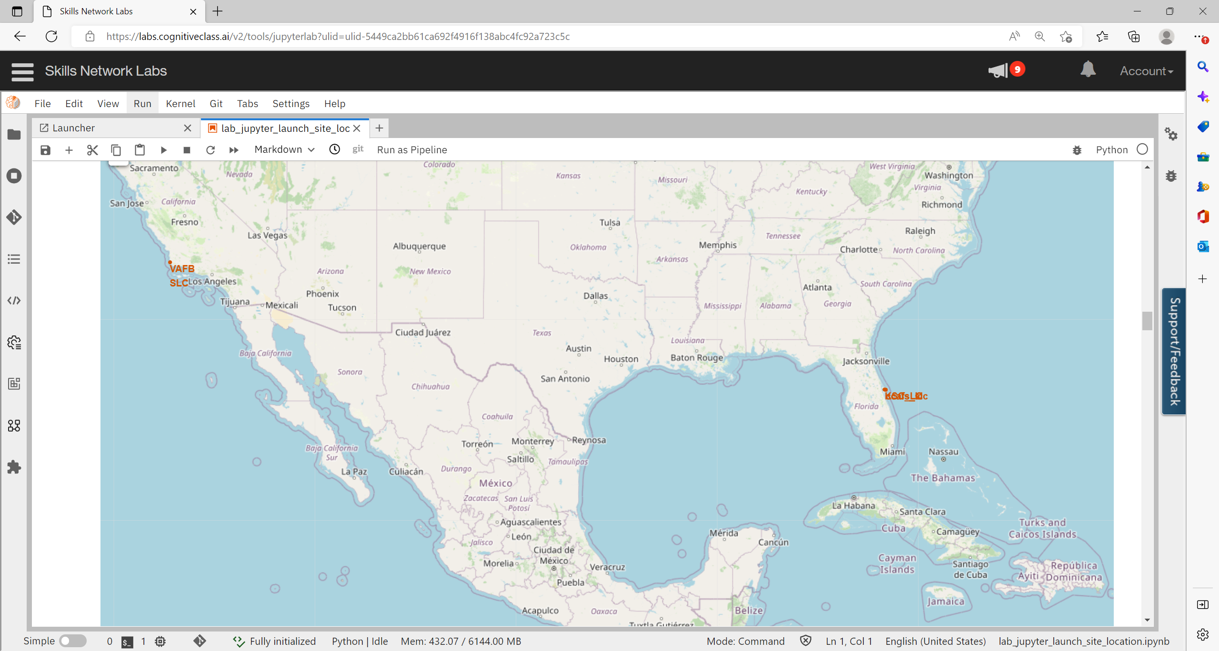
<Folium Map – Launch Sites >
- All launch sites are marked with markers and circles (need to expand to see)
The launch sites are closer to each other except for the VAFB-SLC
All sites are in close proximity to the coast

Slide 38
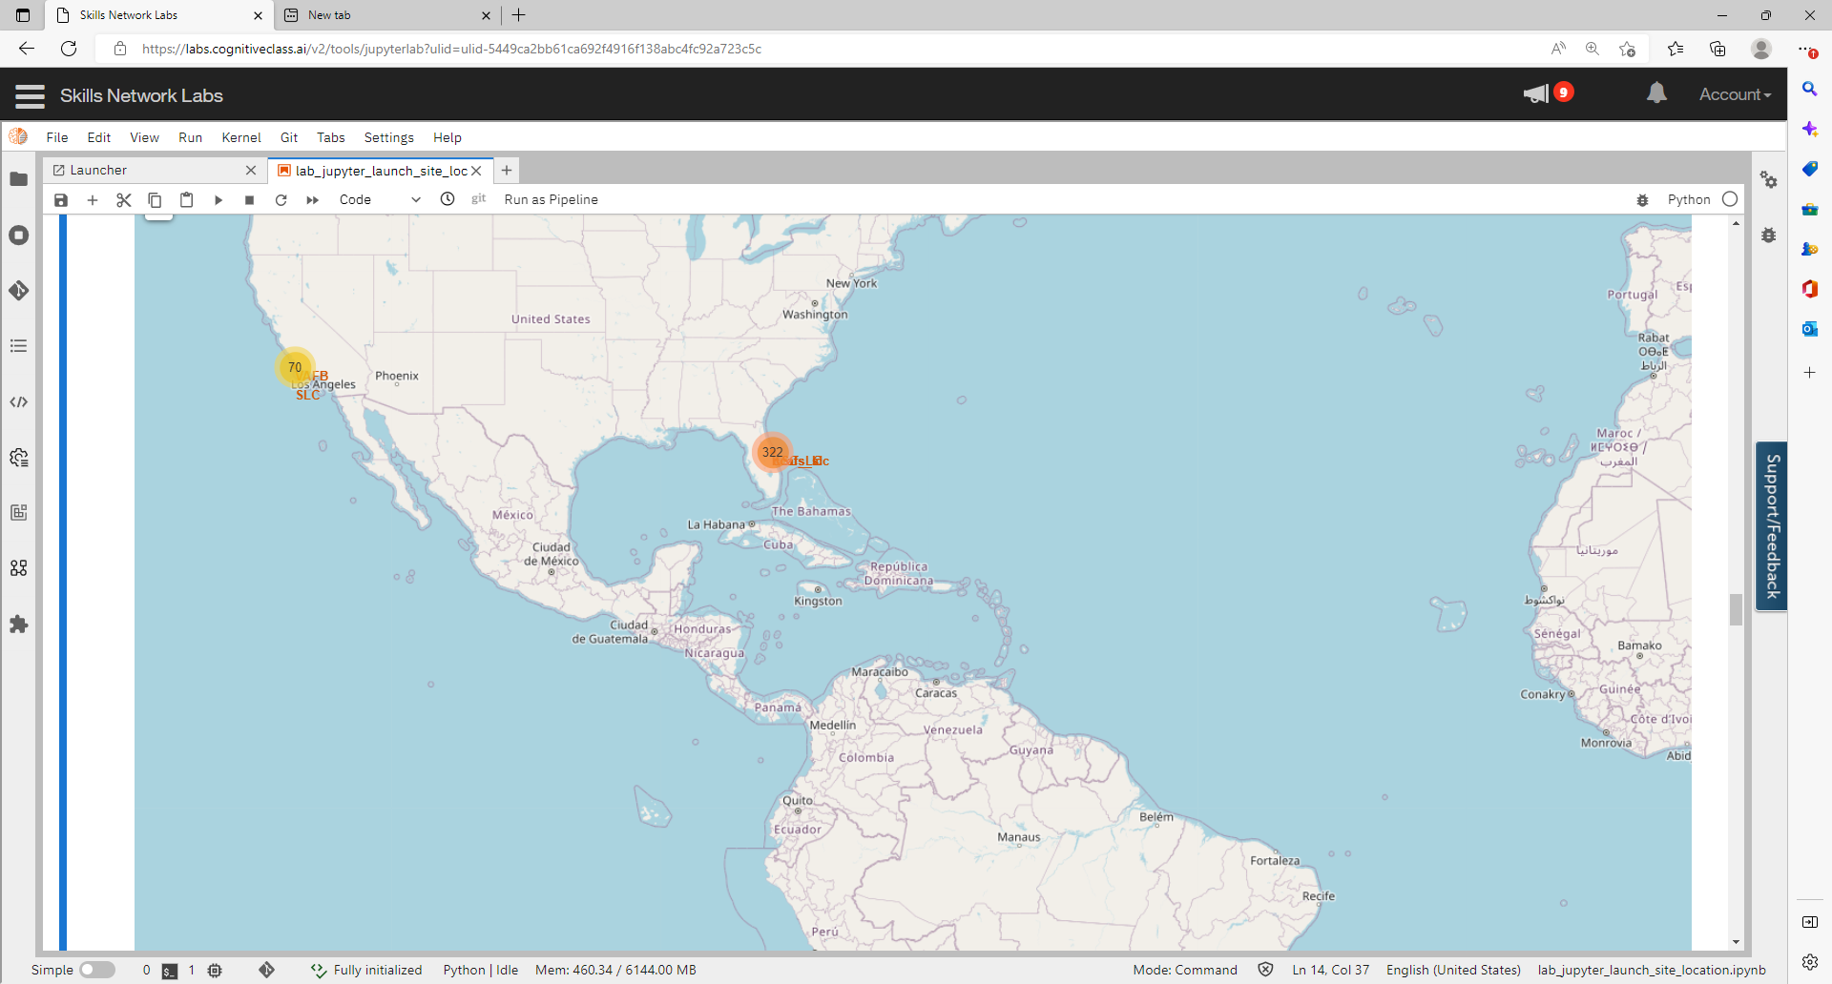
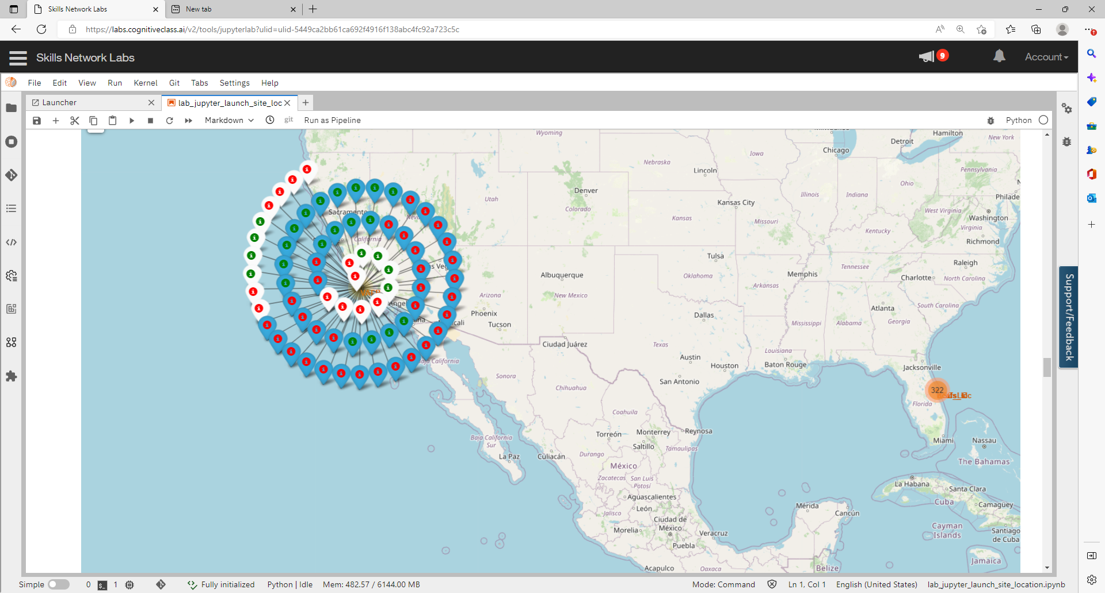
<Folium Map – Launch Success/Failure
The launch sites are color coded based on whether the launch was a success or failure.
Since the launch records have the exact same coordinates, a marker cluster is a good way to simplify the map.

Slide 39
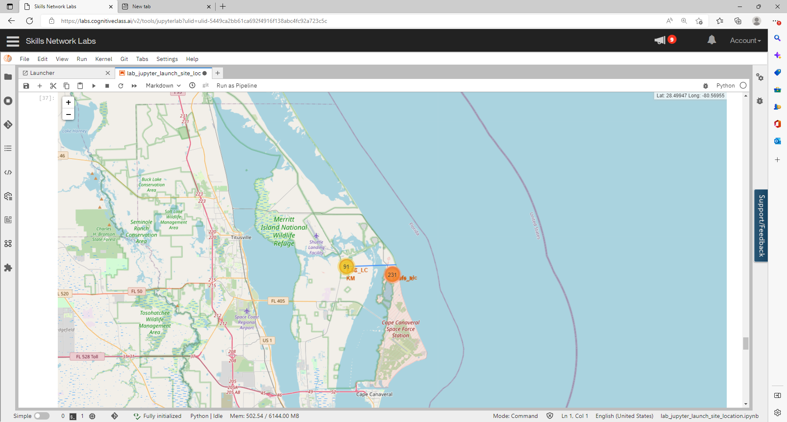
<Folium Map – Distance to Coastline

Slide 40

Section 4

Slide 41
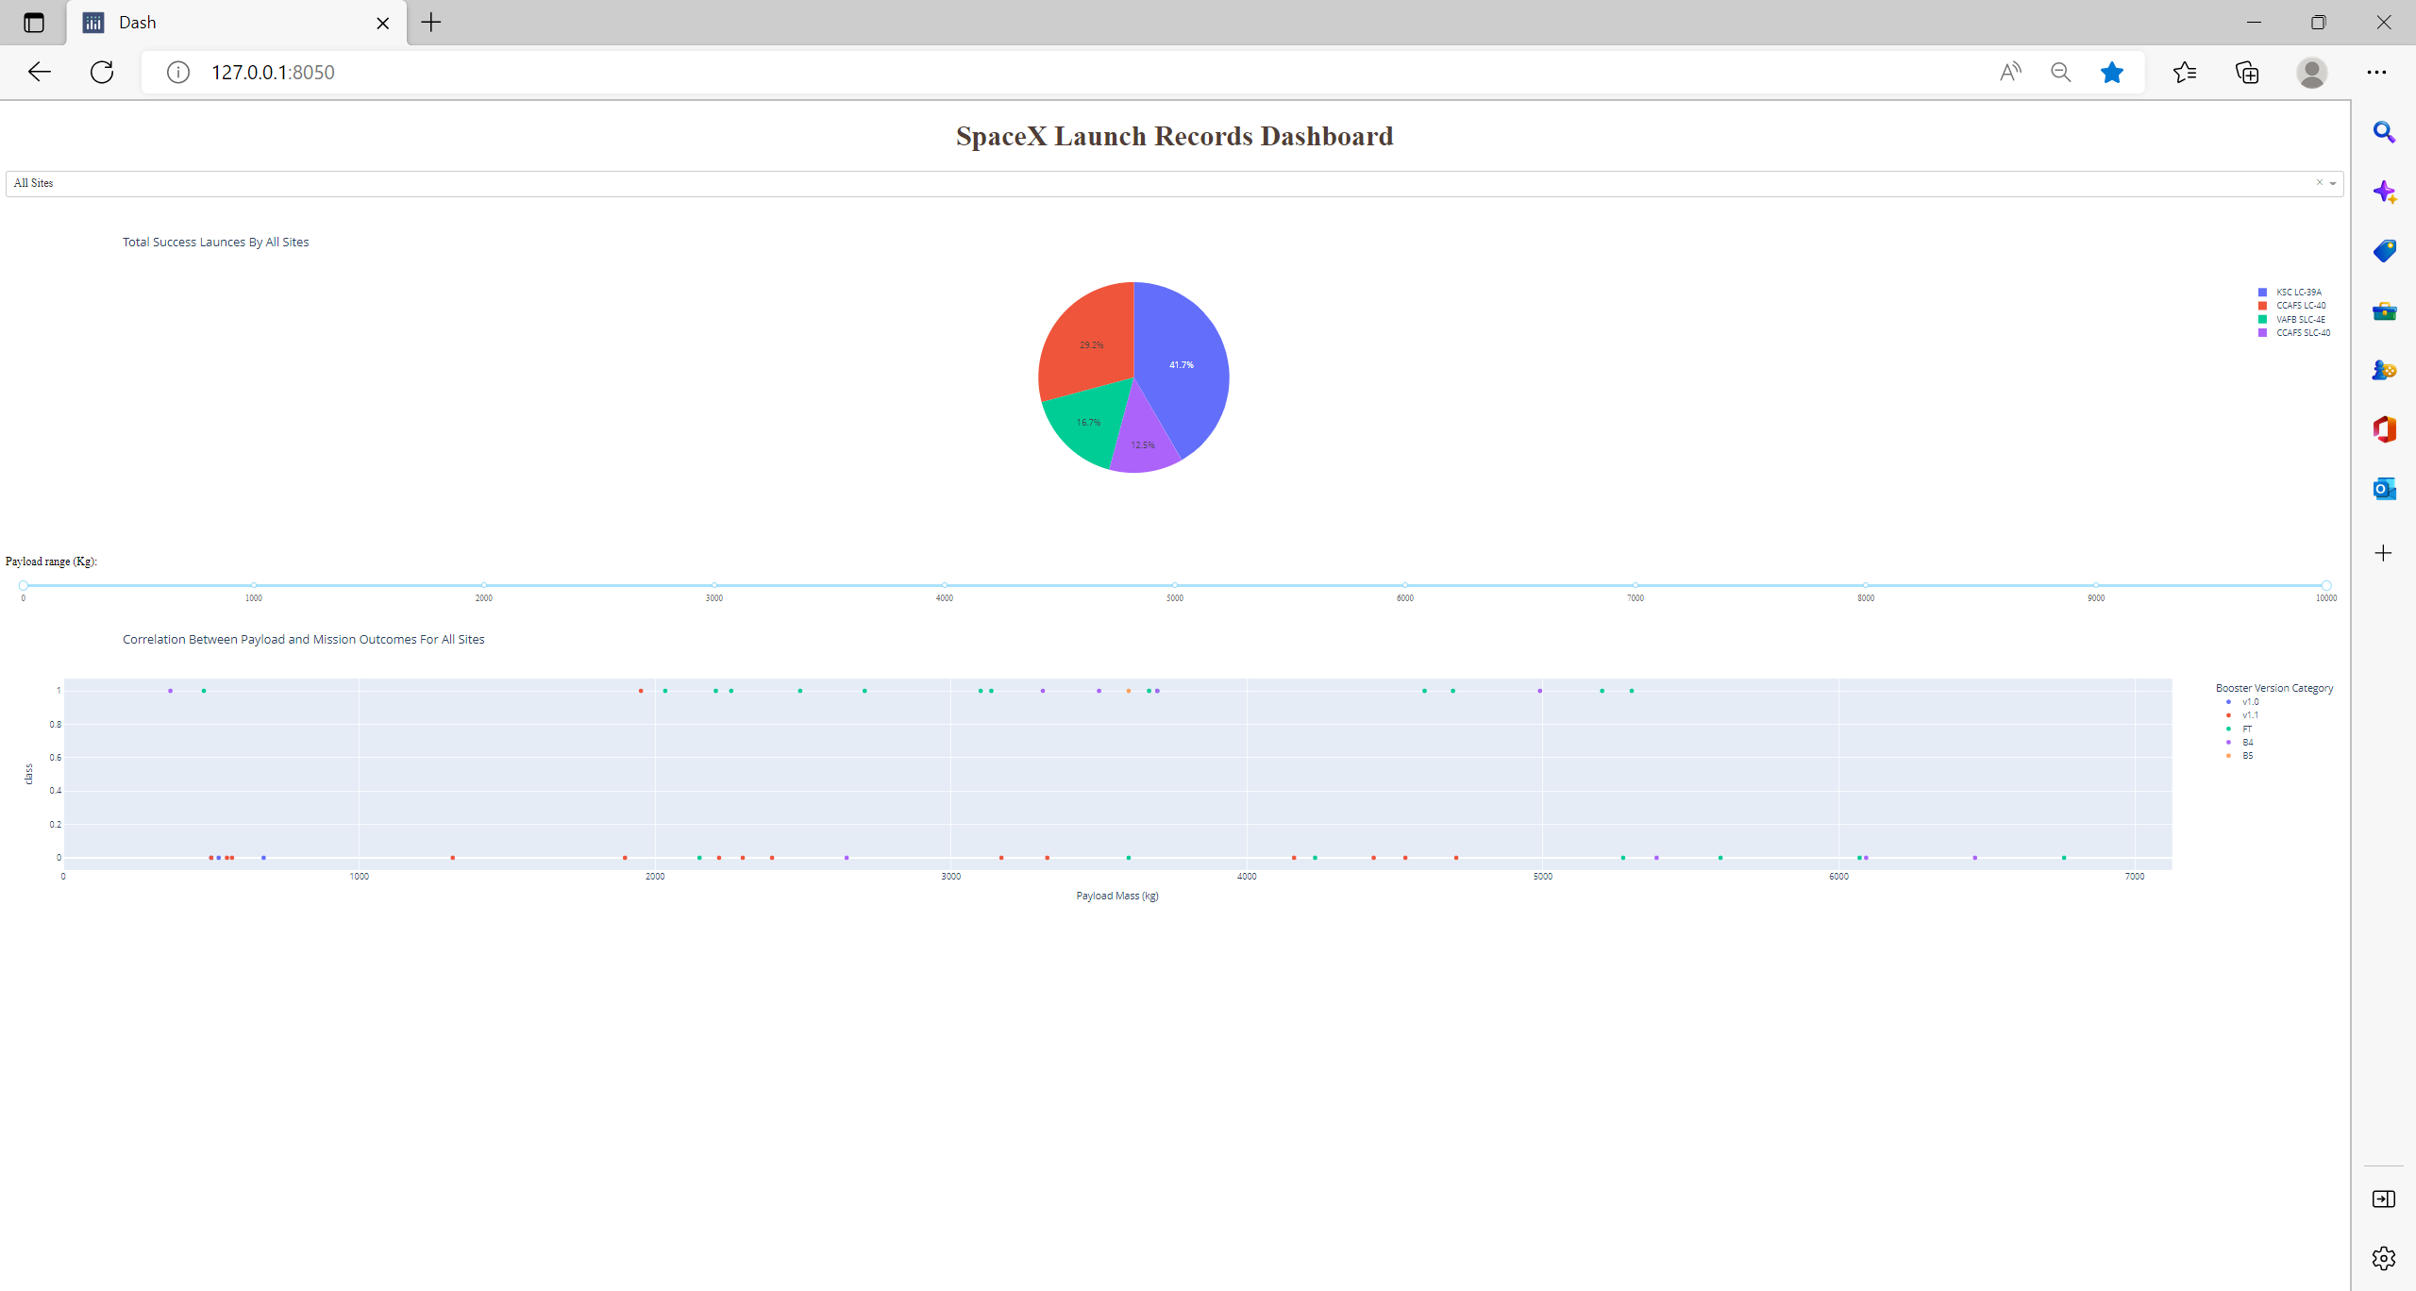
<Dashboard – Launch Success Count>
The chart shows KSC-LC-39A has the most successful launches.
https://github.com/samk-watson/Capstone/blob/main/plotly_dash.py

Slide 42
Highest Launch Success Rate
Explanation:
KSC-LC-39A has the highest launch success rate.
Successful landing – 10
Failed landings – 3
Success rate – 76.9%

Slide 43
Payload vs Launch Outcome
Explanation:
The payloads between 2000 kg and 5500 kg have the highest success rate
https://github.com/samk-watson/Capstone/blob/main/plotly_dash.py

Slide 44

Section 5

Slide 45
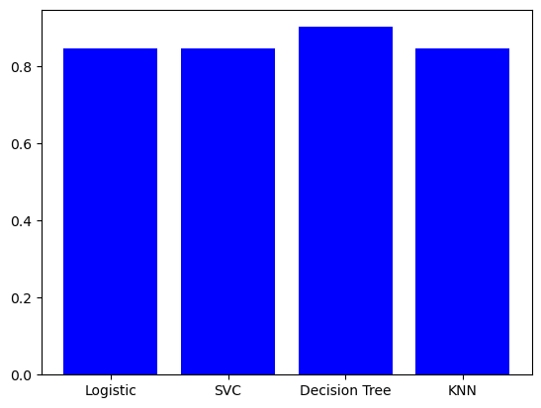
Classification Accuracy
Visualize the built model accuracy for all built classification models, in a bar chart
Find which model has the highest classification accuracy
-- Decision tree has the highest accuracy

Slide 46
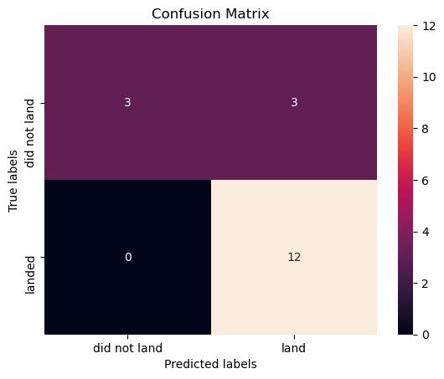
Confusion Matrix
Show the confusion matrix of the best performing model with an explanation

Slide 47
Conclusions
Point 1
Decision Tree Model has the highest accuracy
Point 2
KSC-LC-39A launch site has the highest success rate for the launches.
Point 3
ES-L1, GEO, SSO are the orbits with the highest success rates.

Slide 48
Appendix
Include any relevant assets like Python code snippets, SQL queries, charts, Notebook outputs, or data sets that you may have created during this project

Slide 49


